Slide 1
Project Toolhub
Name : Amol Kumar Gupta
Roll No : 403

Slide 2

Introduction
Toolhub is a website where user can download or buy software, tools at any place. My purpose is to explain how Theme module is built and work.

Slide 3
Objectives
Design and develop an automated and user-friendly service for downloading the tools.
To purpose a modern technique for switching the theme using Tailwindcss.
To analysis the system using Mobile-first Approach.

Slide 4
Implementation and Working
Styling with
Scripting with
Theme System
Tailwindcss
JavaScript

Slide 5
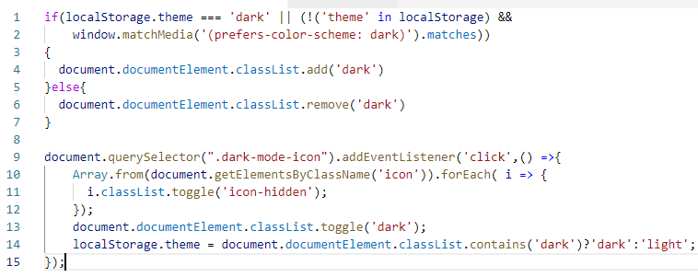


JavaScript logic

Slide 6
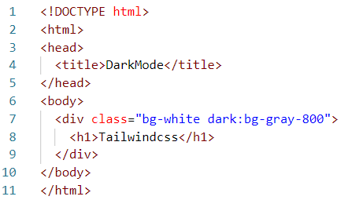
Styling with Tailwindcss
Tailwindcss make it easy to implement theme system with its predefined 'dark' keyword.

Slide 7
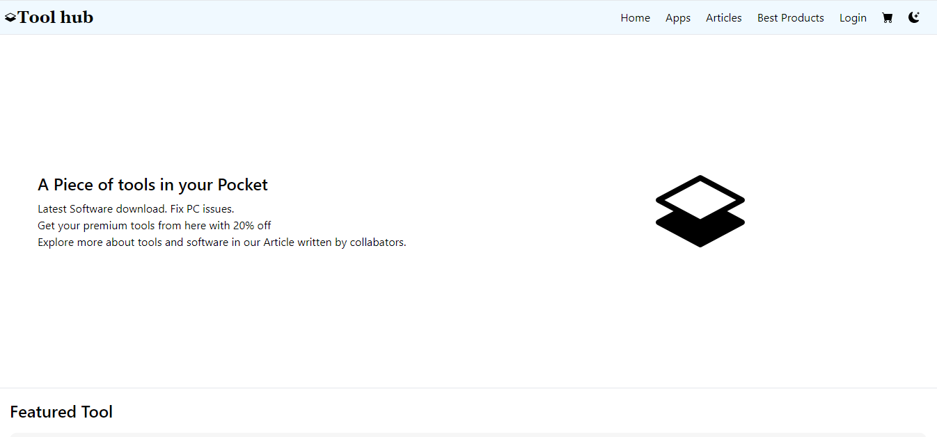
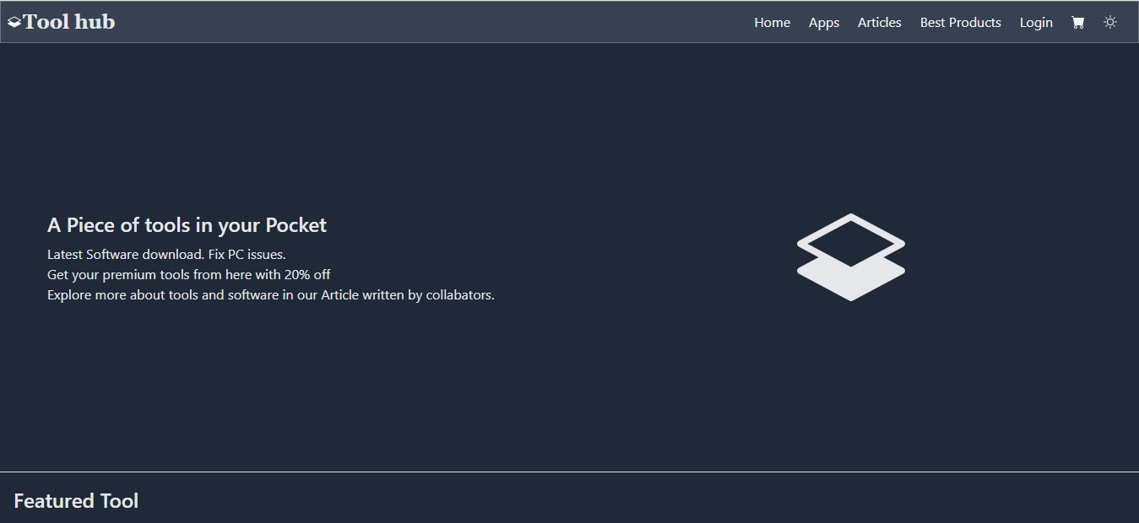
Button for Changing Theme
User can change its Theme according to its need. There are mainly two theme in website.

Slide 8
THANKS!
For your support

